Slide 1
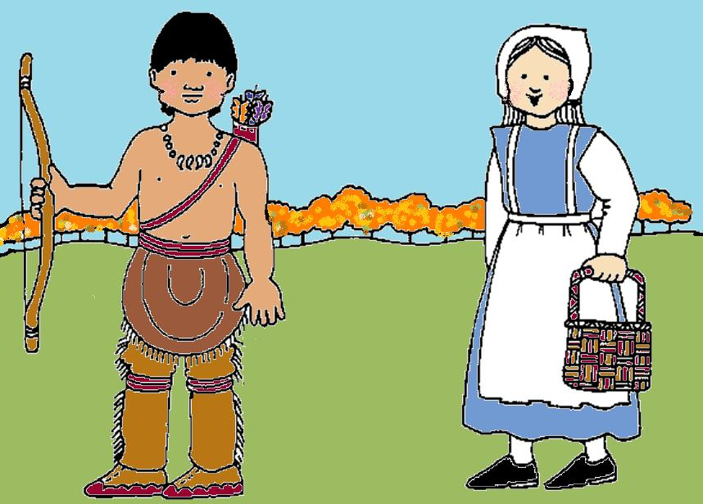
The More We Are Together

Slide 2
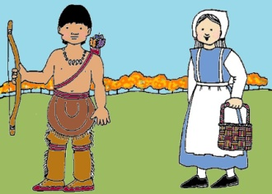
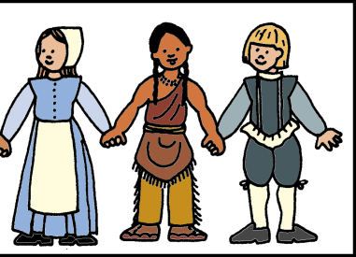
The more we together, together, together,
The more we together, the happier we’ll be.
Cause your are my .
And my are your .
The more we together, the happier we’ll be!

Slide 3
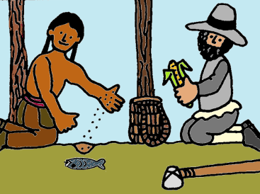
The more we together, together, together,
The more we together, the happier we’ll be.
Cause your are my .
And my are your .
The more we together, the happier we’ll be!

Slide 4
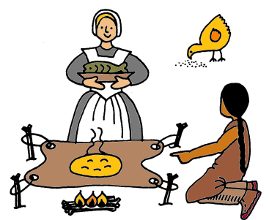
The more we together, together, together,
The more we together, the happier we’ll be.
Cause your help my .
And my help your .
The more we together, the happier we’ll be!

Slide 5
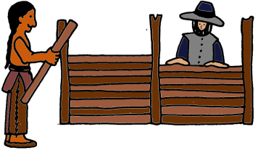
The more we together, together, together,
The more we together, the happier we’ll be.
Cause your is my .
And my is your .
The more we together, the happier we’ll be!

Slide 6
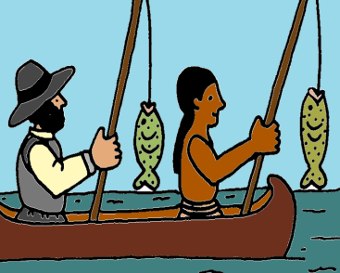
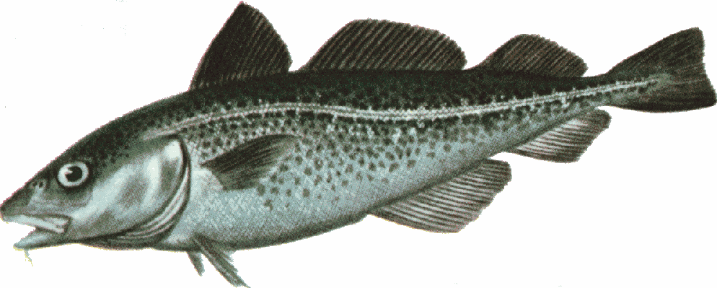
The more we together, together, together,
The more we together, the happier we’ll be.
Cause your are my .
And my are your .
The more we together, the happier we’ll be!

Slide 7
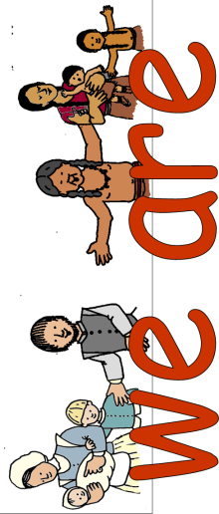
The more together, the happier we’ll be.
The more together, the happier we’ll be!

